Slide 1
Mod 08 BASH Files and Directories Homework
Scripting Essentials
Dr. Burkman

Slide 2
The Goal
Understanding this homework will be key for the project
The goal is to read the file fast_short.pcap line by line and write the date, time, priority, classification, description, source IP and destination IP back as a comma delimited file named alert_data.csv.
As usual, read the entire assignment before starting.
Note that your completed script might take a couple of minutes to run. That is expected.
SFTP the file fast_short.pcap from our sftp server.

Slide 3
Basic Requirement
Solve this by reading the file line by line.
Use string slicing and cut with a delimiter to pick out the correct values to write back. I found it handy to do the ip addresses last, and changing the file input line “}” to “|” before cutting. Trying to cut on “}” results in an error. Cut also only works with a single character.
I highly encourage you to echo your variables as you go along to ensure that you are getting what you need. You only need to print once so use a break to just test one line until you have everything parsed (then delete the break and any spare echo).
Destructively write the header, then append write the data. Echo user warnings per the demo.

Slide 4
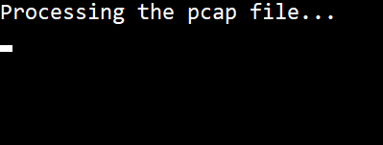

Screen Output
Output while processing:
Output when done (after screen clear):

